Slide 1
Version Control
An overview of concepts

Slide 2
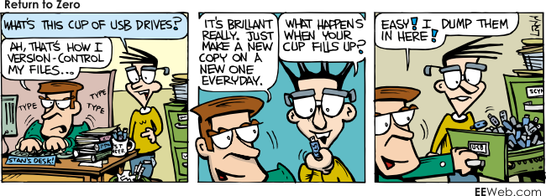
A bad version control system

Slide 3
Wait But Why is this bad
Backups get lost
Cant work with more than one person
Difficult to fork and merge versions
No bug tracking / issue tracking

Slide 4
However!
This approach is valid for small simple single person projects
But only if….
The project is not important
Only one person will ever contribute
The project will be thrown away next week because it must not be important enough to maintain properly
As soon as the project has value, it should be versioned correctly

Slide 5
What is Version Control? What does it do?
A repository for project source files
A repository is a type of database
Backs up multiple versions of files
Tracks changes between versions
Merges changes in files

Slide 6
Why is it useful?
Backup files
Protection against corruption, hardware failure, general forgetfulness
Multiple programmers can work from the same code base, even the same file
Ability to undo changes and revert to older versions
Tracking what changed, and who was responsible for those changes

Slide 7
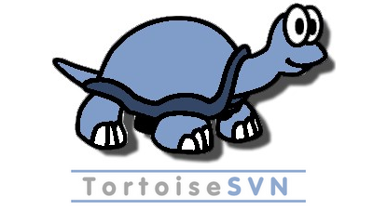
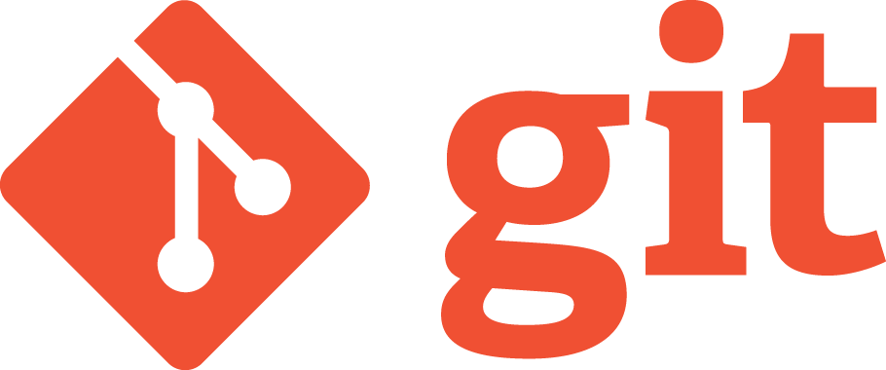

Common Control Software
SVN (Subversion)
Git
Perforce

Slide 8
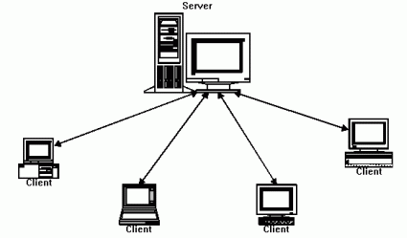
Client / Server Model
Most version control software employs a client / server model
The server
Manages a repository of files
Keeps track of changes
Synchronizes changes with clients
A client
Receives updates from the server
Commits new versions to the server

Slide 9
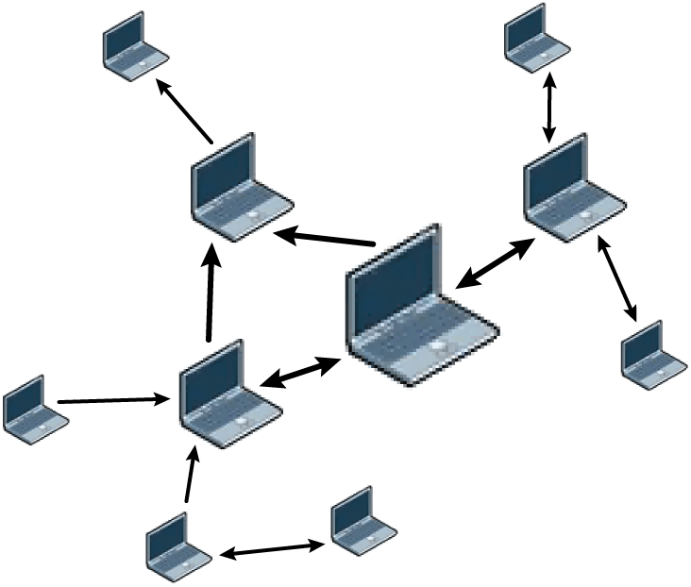
Distributed Model
In a distributed model every developer has their own repository
Multiple programmers can save changes into a common repository if desired
Tends to share changes when desired and not force updates on others

Slide 10
Some definitions
Repository / Depot The database that stores all files
Server The computer that stores the repository
Client Any computer that connects to the repository
Trunk / Main The primary location for code in the repository
Working / Local / Workspace A Copy of versioned files on the client
Head The latest version of the repository
Comment A description of a change

Slide 11
Basic Actions
Checkout(SVN) Obtain a new local copy of the repo
Checkout(P4) Enable editing of a file
Get Revision Get or Update the local copy from the repository
Commit / Submit Commit local changes to the repository
Add Add a local file or directory to the repository
Delete Delete local file or directory from the repository
Rename / Move Rename or move the file.
Revert Throw away local changes and update from the repository
View Log View a list of changes in the repository

Slide 12
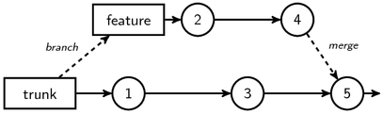
Other Actions
Most software control systems permit the client additional actions
Rename files
Compare different versions
Merge two versions
Create a project branch
A different copy of the same project

Slide 13
Useful Links
TortoiseSVN Subversion Client
http://tortoisesvn.tigris.org
SourceTree Git Client
http://www.sourcetreeapp.com
Perforce
http://www.perforce.com

Slide 14
Summary
Version control is an essential part of managing your work
Version control allows:
Reliable backups
Multiple programmers working on code simultaneously
Undoing changes
Efficient distribution of your project
Don’t be that person who keeps a draw of 20 USB drives to store their backups

Slide 15
Further Reading
TortoiseSVN. 2016. tortoisesvn.tigris.org . [ONLINE] Available at: http://tortoisesvn.tigris.org. [Accessed 10 March 2016].
Atlassia. 2016. SourceTree. [ONLINE] Available at:http://www.sourcetreeapp.com. [Accessed 10 March 2016].
Perforce. 2016. Perforce Software. [ONLINE] Available at: http://www.perforce.com/. [Accessed 10 March 2016].

